Slide 1


Data to information
Analysing graphs

Slide 2

Revision: terminology
Discuss the following terms from last class with the students sitting around you.
Be prepared to discuss the meaning of each term with the whole class:
Graphical representations
Advantages of graphical representations
Graph conventions
Types of Graphs
Bar
Column
Line
Infographic
Histogram
Pie

Slide 3

Analysing graphs: reports
On their own, graphs are useful because they are attractive and they allow the user to quickly and easily understand the data presented.
Graphs can be more useful when they have been analysed and a report added to the graph.
Analysing is the process of interpreting the meaning of the data presented in a graphical representation.
An analysis can be documented in the form of a report.

Slide 4
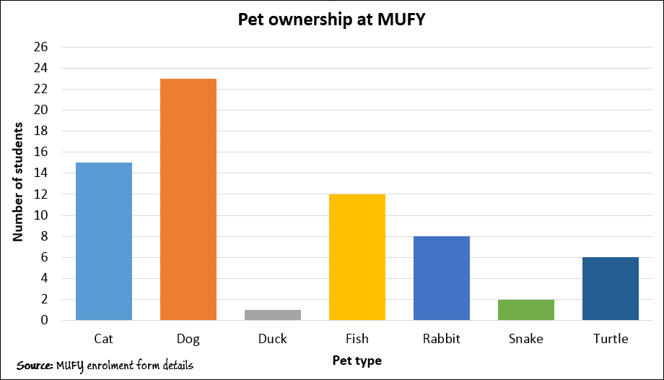
Report structures
The structure of a report used to analyse a graph should include the following sections:
Introduction
Type and purpose of graph
Data included in the graph
Main findings/trend shown in graph
Other findings/trends/reasons in the graph
Source of the data
Conclusion
You may not use each section every time you analyse a graph and/or you may include other sections if you wish.

Slide 5
Report structures
Introduction (one sentence)
Look at the graph title for a clue about the what to write in the introduction.
But do not just copy the title, try and re-phrase the title into a sentence using your own words.

Slide 6
Report structures
Type and purpose of graph (one sentence each)
Describe the type of a graph (e.g. line, chart, pie).
Also write a sentence explaining the main purpose of that type of graph.

Slide 7
Report structures
Data included (one sentence for each data item)
Some graphs may only show one data item, others two and some three.
Write one sentence for each data item shown.

Slide 8
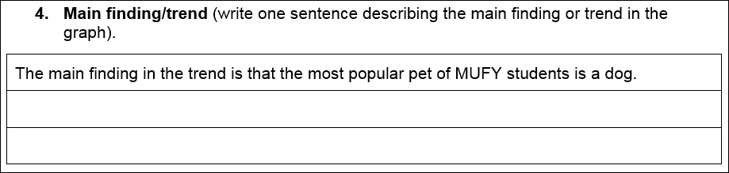
Report structures
Main findings/trend (one sentence)
Write one sentence to explain the main point that the graph is showing.
Don’t worry about minor details.
The main trend should be linked to the purpose of the graph.

Slide 9
Report structures
Other findings (one sentence for each point)
This allows you to explain other interesting areas found in the data.
It could include factors that affected the main trend or other significant events that are shown in the graph.

Slide 10
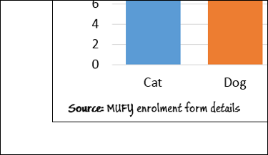
Report structures
Source of the data (one sentence)
The source of the data indicates where the data comes from.
Showing the source of the data improves the reliability of the data.
This means the we can trust the data is accurate.
But the source may not always be available or reliable.
We will study sources of data in more detail soon.

Slide 11
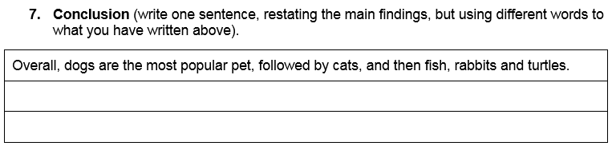
Report structures
Conclusion (one sentence)
The conclusion should summarise all of the findings identified earlier in the report.
Avoid copying the findings directly from the earlier sections. Rather, try to re-word the findings.

Slide 12
Report structures
Other information
You may wish to add further sections to your report if you wish, particularly if you feel the additional detail will add to the information you have already presented.

Slide 13
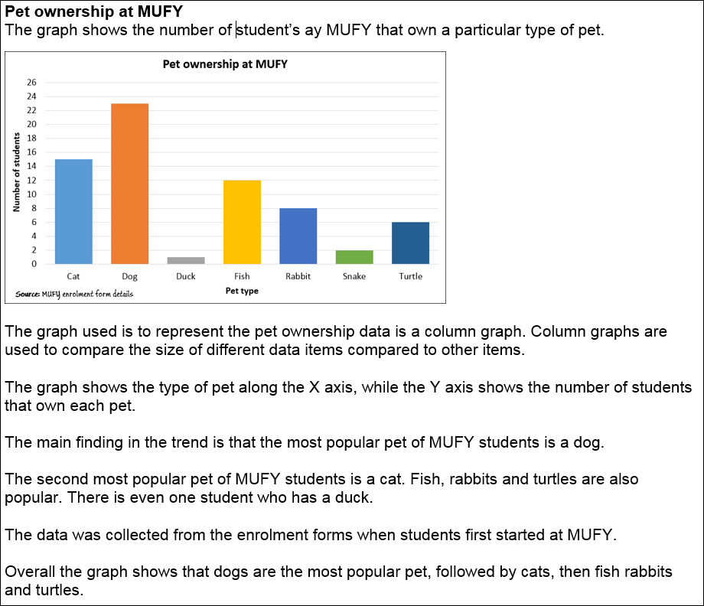
Report structures
Putting it all together
You may wish to cut and paste each section into a new document.
Make each section a new paragraph.
Use a screenshot of the graph too.
You can include sub-headings for each section or remove them if you like.
You have then created an analysis report.
The report shown is 152 words.

Slide 14
Activity: Pet ownership report
Download the Pet ownership worksheet from eLearn.
Complete the worksheet on your device.
Alternatively, you can print off the worksheet and complete it by hand.
Note:
All of your end of semester exams require you to write by hand – so the more you practice writing in English, by hand, the better.

Slide 15
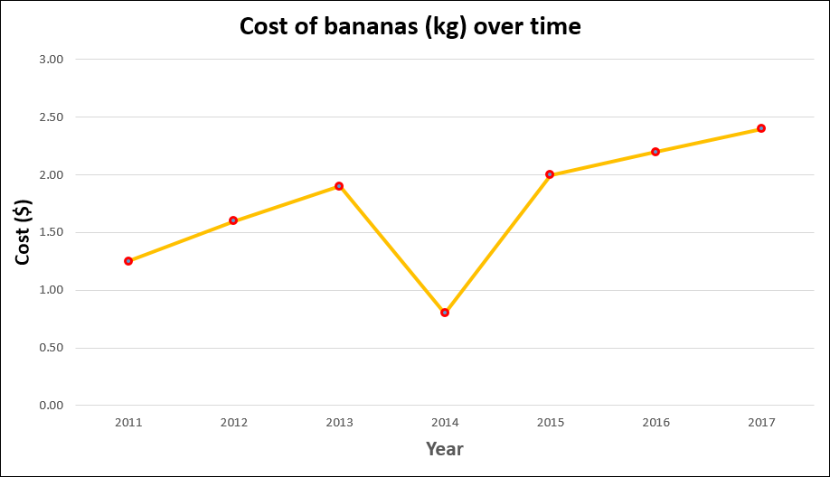
Activity: Cost of bananas analysis
Download the Cost of bananas worksheet from eLearn.
Complete the worksheet on your device.
Alternatively, you can print off the worksheet and complete it by hand.
Note:
All of your end of semester exams require you to write by hand – so the more you practice writing in English, by hand, the better.

Slide 16

Activity: MUFY teachers analysis
Download the MUFY teachers worksheet from eLearn.
Complete the worksheet on your device.
Alternatively, you can print off the worksheet and complete it by hand.
Note:
All of your end of semester exams require you to write by hand – so the more you practice writing in English, by hand, the better.

Slide 17
Notes/Glossary
Create notes using the Cornell notes method describing the elements that make up an Graphical Analysis Report:
Introduction
Type and purpose of graph
Data included in the graph
Main findings/trend shown in graph
Other findings/trends/reasons in the graph
Source of the data
Conclusion

Slide 18
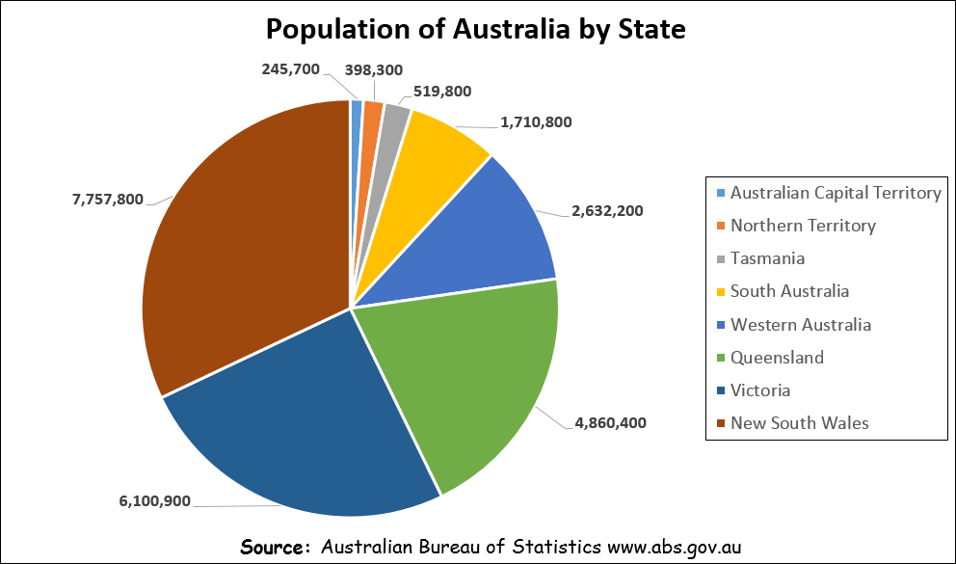
Post-class activity: graph analysis report (submission)
Complete an analysis report on the graph shown for homework.
Download the worksheet from eLearn.
Use the analysis report template to assist you.
Do not forget to upload your completed report to eLearn.

